Slide 1
Numerical Analysis
Introduction to MATLAB
Lab4

Slide 2
Graphics on MATLAB
MATLAB produce 1, 2 and 3 dim plots of curves and surface
Simple 1D graphics Example
  Linear scales
2D graphics

Slide 3
Plot
plot(Y)
%plots the columns of Y versus their index if Y is a real number.
plot(X1,Y1,...)
% plot(X1,Y1,...) plots all lines defined by Xn versus Yn pairs.
plot(X1,Y1,LineSpec,...)
%plot all line Xn versus Yn and apply line spec

Slide 4
LineSpec
LineSpec property is used to Specify the types of lines used for plotting.
  Line style
  Color
  Marker type

Slide 5
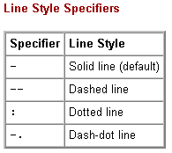
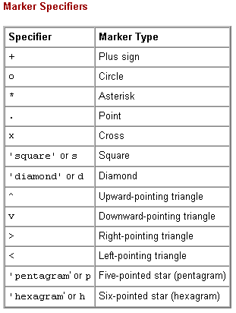
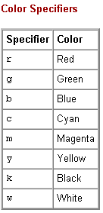
LineSpec

Slide 6
Examples
    t = 0:pi/20:2*pi;
    plot(t,sin(t),'-.r*')
    hold on
    plot(t,sin(t-pi/2),'--mo')
    plot(t,sin(t-pi),':bs')
    hold off

Slide 7
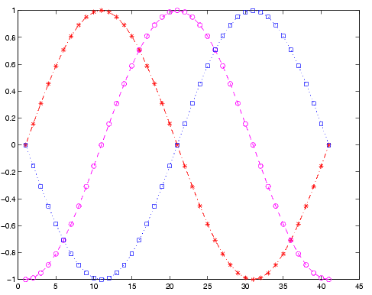

Slide 8
Examples
% generates a row vector of 100 linearly equally spaced points
x=linspace(0,1);
hold on % holds the current plot
for n=0:10 % Loop 0 to 10
y=x.^n.*exp(x); % * for Matrix and .* for Array
plot(x,y,'k') % k for block or b for blue
end % End of Loop

Slide 9
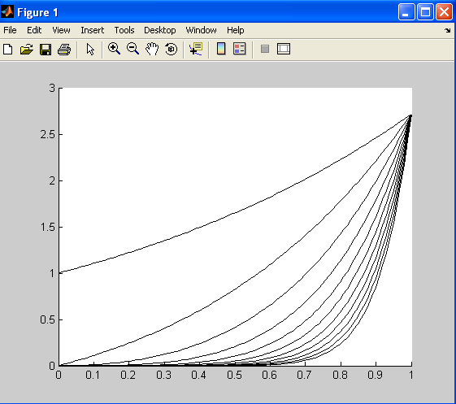

Slide 10
Examples
plot() – draws a set of ordered pairs of points with or without lines. e.g. y=cos(x) and z=cos²(x) over interval [0,pi].
  x=-pi:0.1:pi; % specifies the domain
  y=cos(x); % define 1st function
  z=cos(x).^2; % define 2nd function
  plot(x,y,x,z,’o’) % display graph. (x, y 1st fun , x, z 2nd fun )

Slide 11
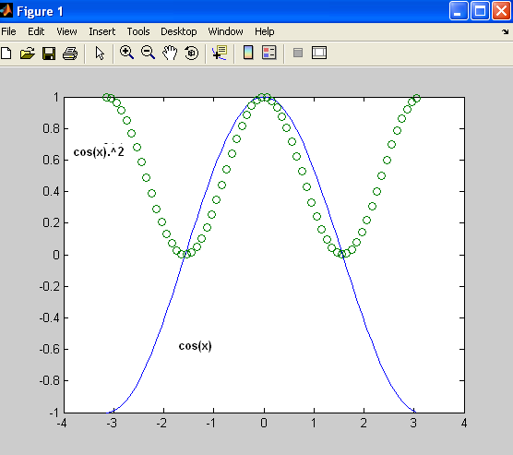

Slide 12
User Defined Function
Functions are M-files that can accept input arguments and return output arguments.
The names of the M-file and of the function should be the same.
  function [out1, out2, ...] = funname(in1, in2, ...)

Slide 13
Example
stat.m defines a new function called stat that calculates the mean and standard deviation of a vector:
  function [mean,stdev] = stat(x)
    n = length(x);
    mean = sum(x)/n;
    stdev = sqrt(sum((x-mean).^2/n));
Function Call
  x=linspace(0,1);
  [m s]=stat(x)

Slide 14
Sub Functions
It is an other function is created in same file after the body of main function.
Sub function is visible to only other functions in the same file.
Subfunctions are not visible outside the file where they are defined.

Slide 15
Example
%avg is a subfunction within the file stat.m:
  function [mean, stdev] = stat(x)
    n = length(x);
    mean = avg(x,n);
    stdev = sqrt(sum((x-avg(x,n)).^2)/n);
% it is a sub function
  function mean = avg(x,n)
    mean = sum(x)/n;

Slide 16
Examples
fplot() – draw curve of a one-dimensional function.
  fplot(‘name’,[a,b],n) % plot name.m by sampling n points in interval [a,b]
>>fplot(‘cos’,[-2,2]) % plots y=tanh(x) over [-2,2]

Slide 17
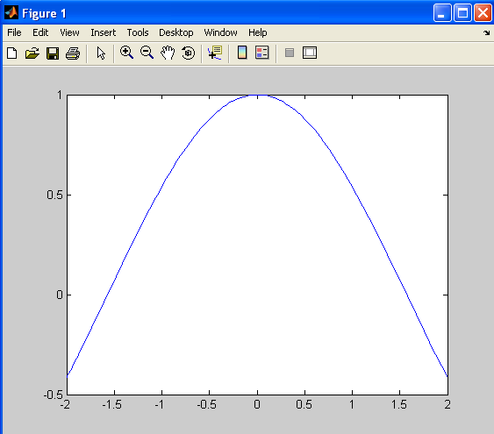

Slide 18
Examples
ezplot() – Easy to use function plotter.
  ezplot(fun)
  %plots the expression fun(x) over the default domain -2pi< x < 2pi
  ezplot(fun,[min,max])
  ezplot(fun,[xmin,xmax,ymin,ymax])
  Ex. x2 - y4 = 0 over the domain [-2pi, 2pi]:
  ezplot('x^2-y^4')

Slide 19
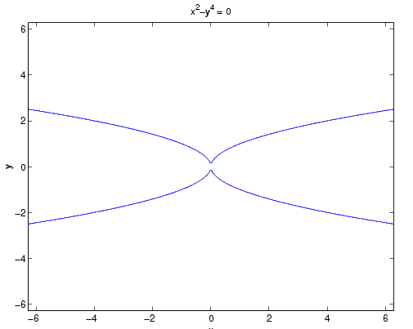

Slide 20
Examples
time=[0:0.01:6]
y=cos(time)
Generating data
Plot y verses time x- axis is time
y- axis is y
plot(time,y)
xlabel('time')
ylabel(‘cos(time) ')
title(' plot of time and cos(time) ')
grid
Add a label to the x- axis
Add a label to the y- axis
Add a title
Add grid lines

Slide 21
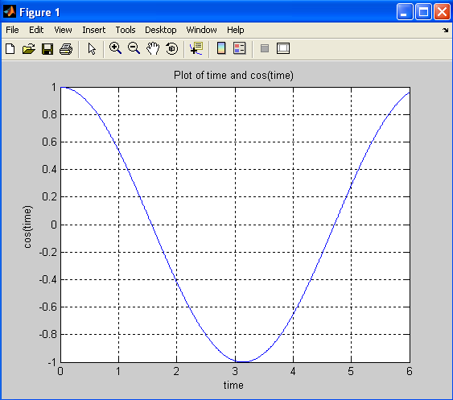

Slide 22
Examples
Plot ellipse c(t)=(2cos(t),3sin(t)), where 0<=t<=2pi
    t=0:0.2:2*pi;
    plot(2*cos(t),3*sin(t))

Slide 23
Examples
time=[0:0.01:6]
Y=sin(time)
Generating data
Plot Y verses index x- axis is column #
y- axis is Y
plot(Y)
semilogx(time,Y)
Plot Y verses time
x- axis is time (log scale)
y- axis is Y (linear scale)
semilogy(time,Y)
Plot Y verses v
x- axis is v (linear scale)
y- axis is Y (log scale)
loglog(time,Y)
Plot Y verses v
x- axis is v (log scale)
y- axis is Y (log scale)
You can modify the scales directly on the figure Click Edit-→ axis properties

Slide 24

Taylor Series
Taylor function returns the Taylor series approximation
r = taylor(f)
r = taylor(f,n,v)
r = taylor(f,n,v,a)
f is a symbolic expression representing a function
v specifies the independent variable in the expression
a about which the series will represented
n (n-1)-order Maclaurin polynomial approximation

Slide 25
Example
  syms x
  f = 1/(5+4*cos(x))
  T = taylor(f,8)
T =1/9+2/81*x^2+5/1458*x^4+49/131220*x^6

